Slide 1
CLASSROOM DEBATE
ORGANIZATION AND RULES

Slide 2
CLASSROOM DEBATE
WHAT IS IT?
In a classroom debate, students argue for and against a given topic without trying to find a solution.
PURPOSE
To develop communication skills, analytical thinking and respect for others;
To improve students’ knowledge of a specific topic

Slide 3
TEACHER´S ROLE
Introduces the activity
Distributes different students´ roles
Selects the topic
Watches the development of the activity
Writes on blackboard main arguments from both teams
Summarises the conclusions of the debate

Slide 4
POSSIBLE QUESTIONS
You do not choose your sexual orientation; you are born straight or gay.
If you identify as LGBT, you should come out to your family and friends.
Members of the LGBT community should be allowed to get married.
LGBT couples should be allowed to adopt children.
LGBT celebrities should come out to champion LGBT rights.
Gay men are feminine and gay women are masculine.
It’s okay to judge someone else’s sexuality.

Slide 5
DISTRIBUTING ROLES
WHO’S WHO?
MODERATOR
TEAM MEMBERS
BELL-PERSON
OBSERVERS

Slide 6
TEAM MEMBERS
Students are divided into two teams:
proposition
opposition
Approximately 10 students per team
Students present their arguments, ask and answer questions, and draw conclusions

Slide 7
MODERATOR
Directs the debate:
Assigns turns to speak
Ensures the rules are respected

Slide 8
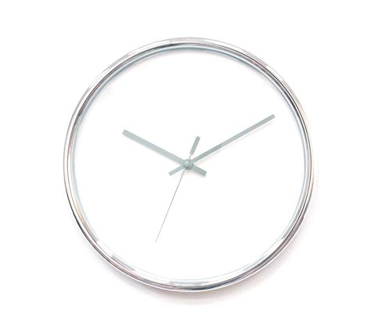
BELL-PERSON
Makes sure that teams are allocated the same amount of time to speak
Rings a bell when time is up

Slide 9
OBSERVERS
2 - 4 students
Note the required items on the observation chart
Present their conclusions at the end

Slide 10
GENERAL RULES
All students should contribute to the debate
Students should focus on the topic
Students should listen carefully and respect their classmates
This is not about winning or losing; it is about learning
Students who don’t respect these rules are removed from the debate and take place in the audience

Slide 11
TIMING (50´)
Duration | Goal
10´ | Presentation of the activity & Give topic
5´ | Questions / Doubts
10´ | Students prepare arguments in groups
2´x 2 | Each team presents arguments
1´x 6 | Counter-arguments
5´ | Reflection & Conclusions in groups
2´x 2 | Give final conclusions
4´ | Observers´ evaluation
2´ | Teacher´s final conlusion

